Slide 1
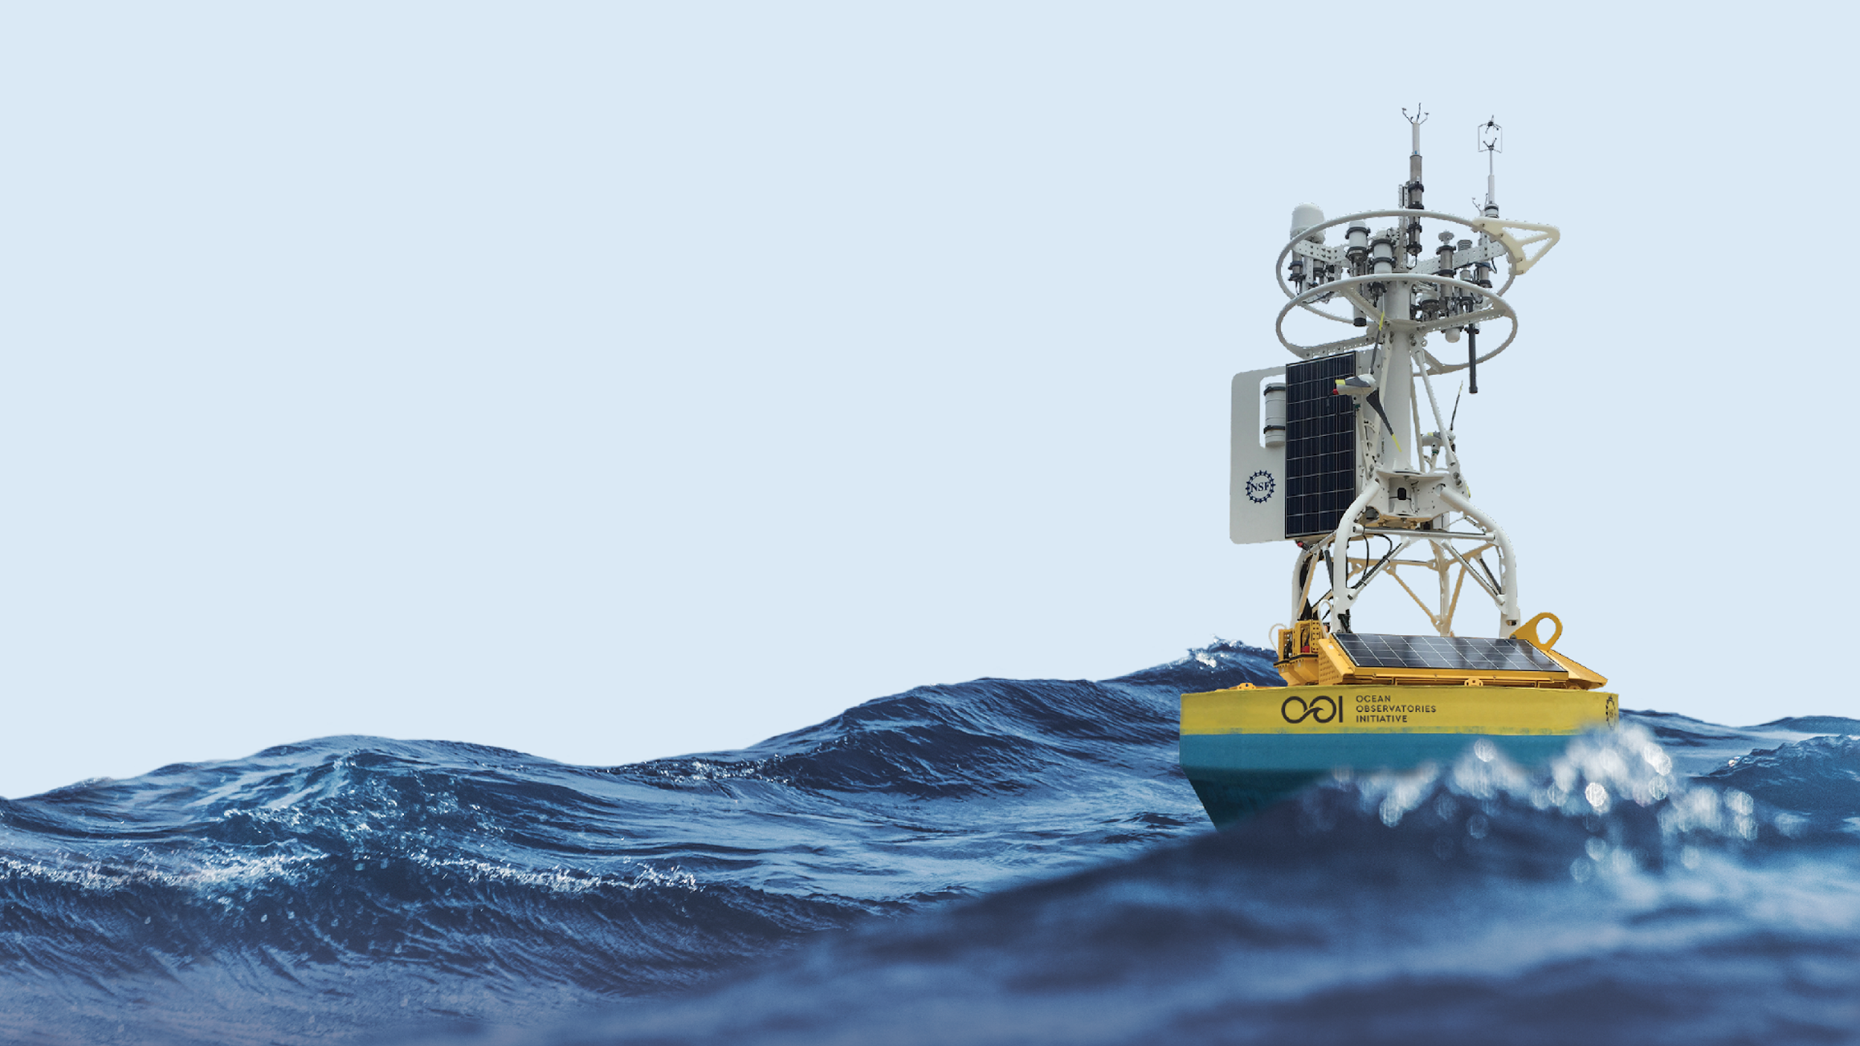



QARTOD in Practice:
Two examples from the Ocean Observatories Initiative
March 4th, 2022 Andrew Reed

Slide 2
Outline
Introduction
What is OOI
Motivation
Vocab
Methods
Results
Gross Range Test
Climatology Test
Conclusions
Resources

Slide 3
Motivation
QARTOD (Quality Assurance Real-Time Oceanographic Data) describes a series of tests for automated quality control of ocean data
QARTOD tests require inputs, values, and thresholds against which to check data
This means data QC is sensitive to choice of inputs
Motivation: How well does OOI’s approach for QARTOD perform for quality control of OOI’s time series data?
Use two physical phenomena to analyze how well OOI’s fitting of QARTOD thresholds for Gross Range and Climatology performed with flagging data
Case 1: Freshening of mid-water column in the Irminger Sea
Look at effect of fitting gross range thresholds to a long term trend?
Do the choices for fitting and thresholds accurately?
Case 2: Passage of an eddy across the Argentine Basin Array
How well does the climatology fitting respond to a large deviation in data?
Does it sufficiently capture the physical phenomena of the eddy with its flags?

Slide 4
Vocab
Array
A collection of moorings and vehicles in a particular location (e.g. Global Irminger Array = Irminger Sea)
Deployment
A span of time a mooring or instrument were deployed and then recovered
Reference Designator (refdes)
An ID which indicates a particular location on an array for a particular type of instrument
Ex: GI01SUMO-RII11-02-CTDMOQ015= Global Irminger Surface Mooring - Instrument Riser - CTD (located at 350 m depth)
A reference designator will have multiple deployments of different CTDs at the same location to make a timeseries
QARTOD/QC Flags
Indicate the data quality of a given data-point
Definitions
1: Good
2: Not evaluated
3: Suspicious or Interesting
4: Bad
9: Missing
Notes:
https://oceanobservatories.org/knowledgebase/how-to-decipher-a-reference-designator/

Slide 5
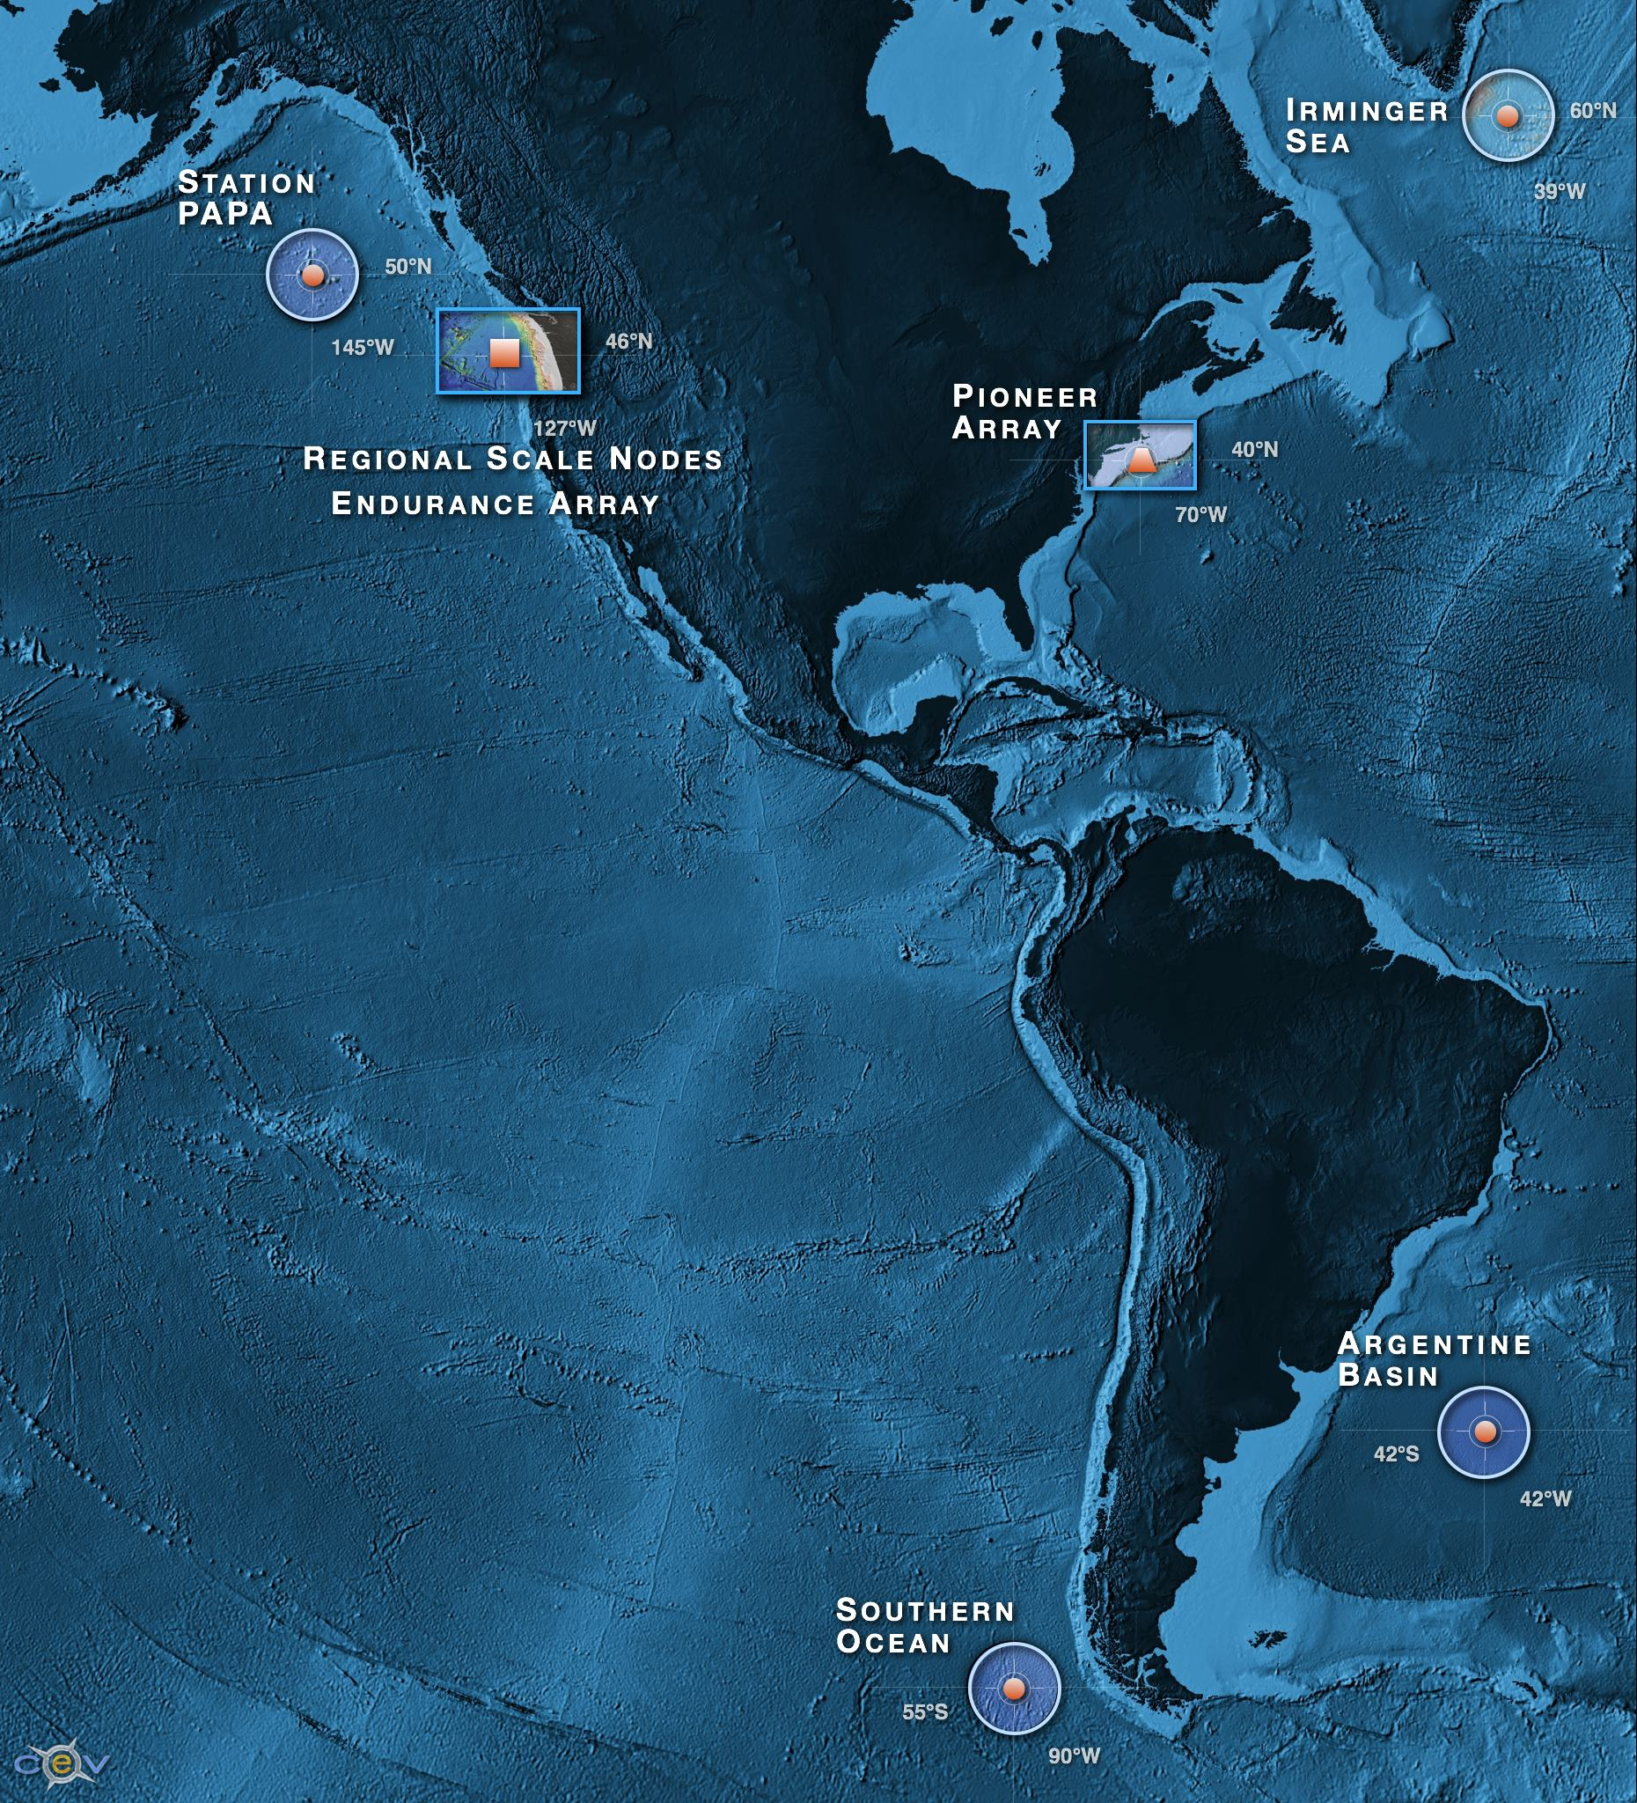
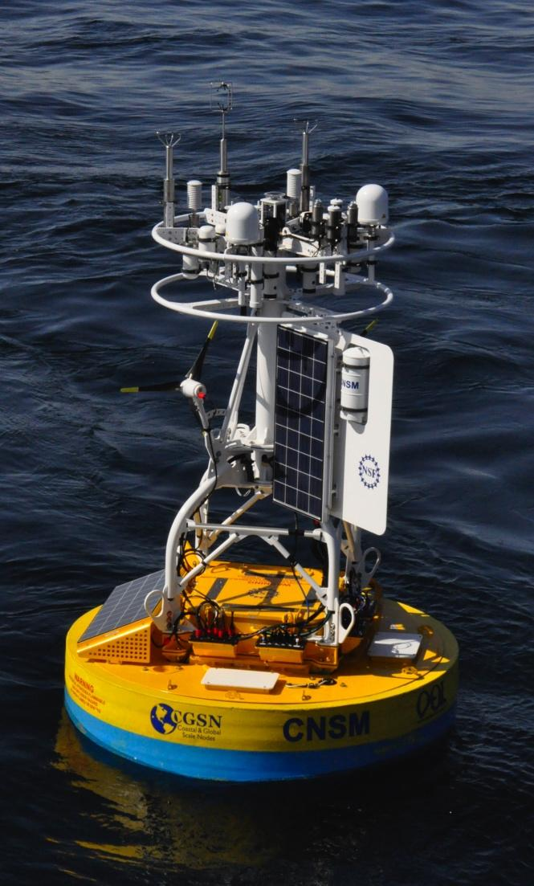
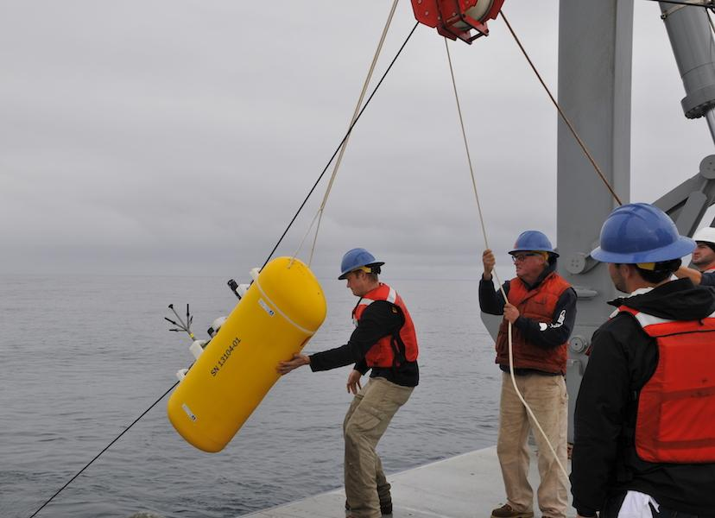
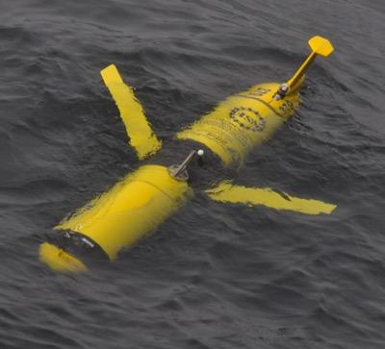

Ocean Observatories Initiative
NSF-funded project for long-term (25 years) infrastructure for ocean observations
Three main elements:
Regional Cabled Array (RCA) array
Endurance Array (EA) on the Oregon-Washington shelf
Coastal & Global Scale Nodes (CGSN) with moorings in the Irminger Sea, at Station Papa, in the Southern Ocean & Argentine Basin (descoped), and the Pioneer Array in the mid-Atlantic bight
CGSN infrastructure includes:
Surface moorings equipped with instruments on the buoy, at 7 m-12 m depth, along the mooring riser, and on the anchor
Profiling moorings, with one or more wire following profilers and ADCPs
Gliders (3 & 12 month deployments)
AUVs
Subhead only
Notes:
Talk about how WHOI is responsible for Irminger, Pioneer, Papa, Argentine (descoped), and Southern (descoped)

Slide 6
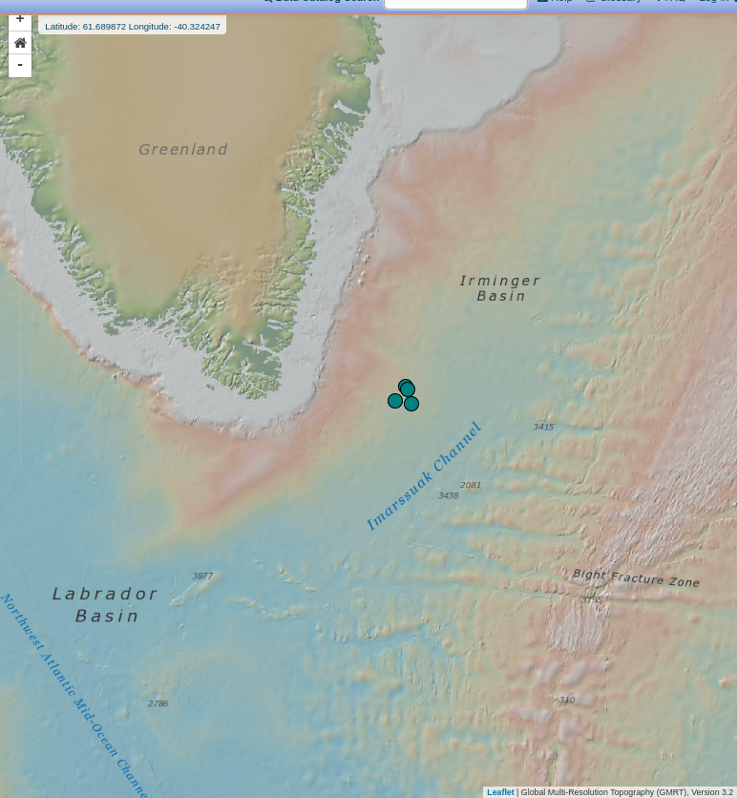
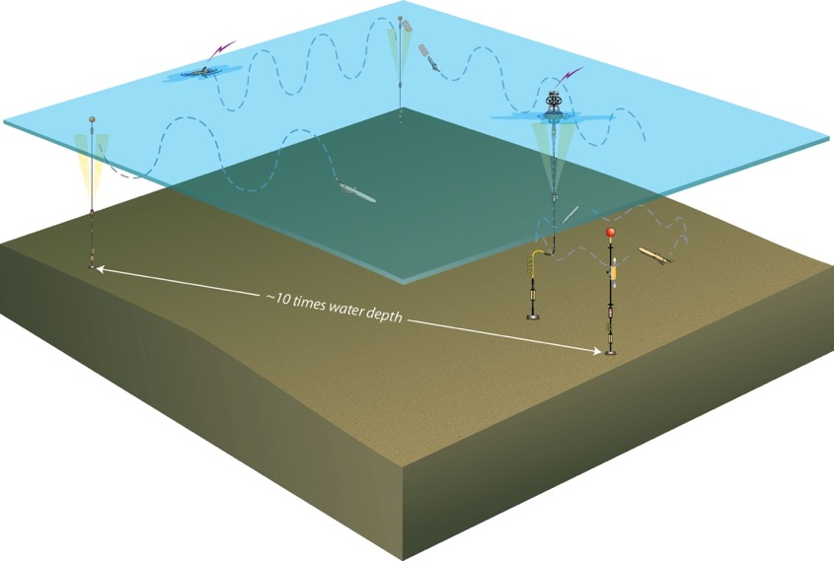
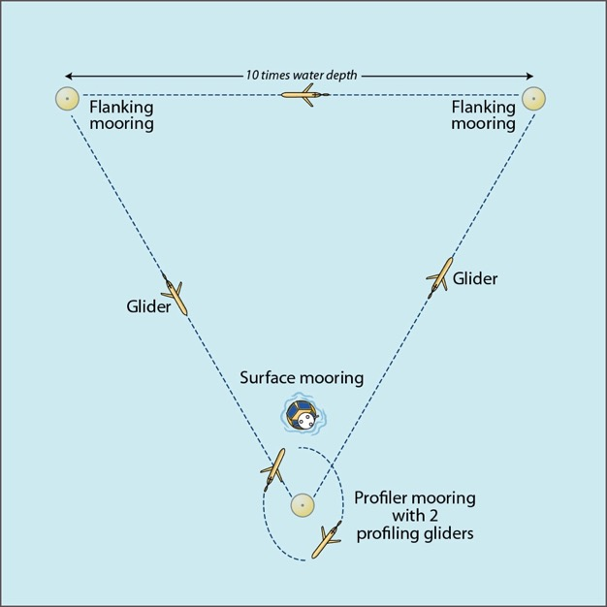
Global Array

Slide 7
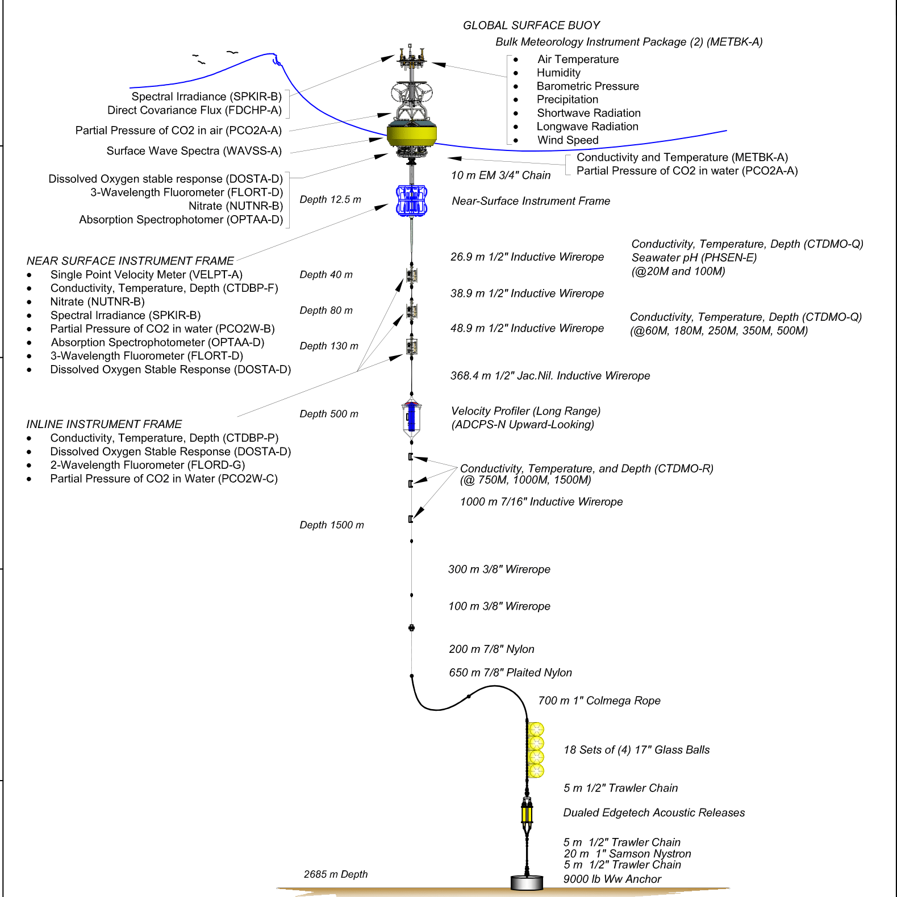
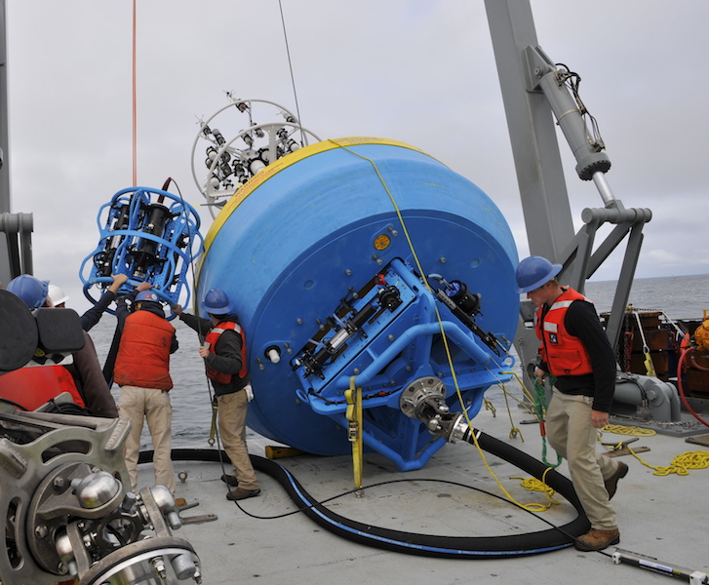
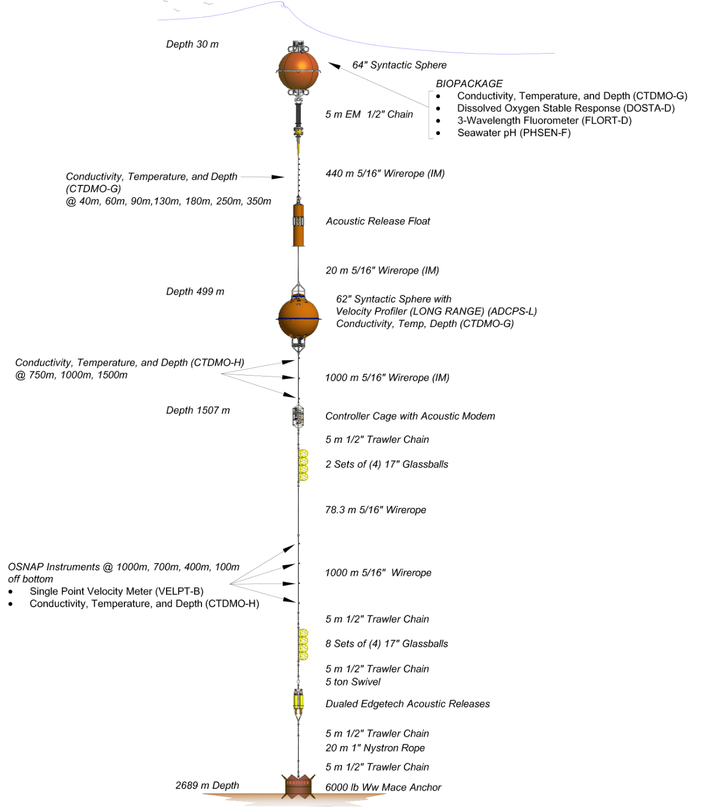
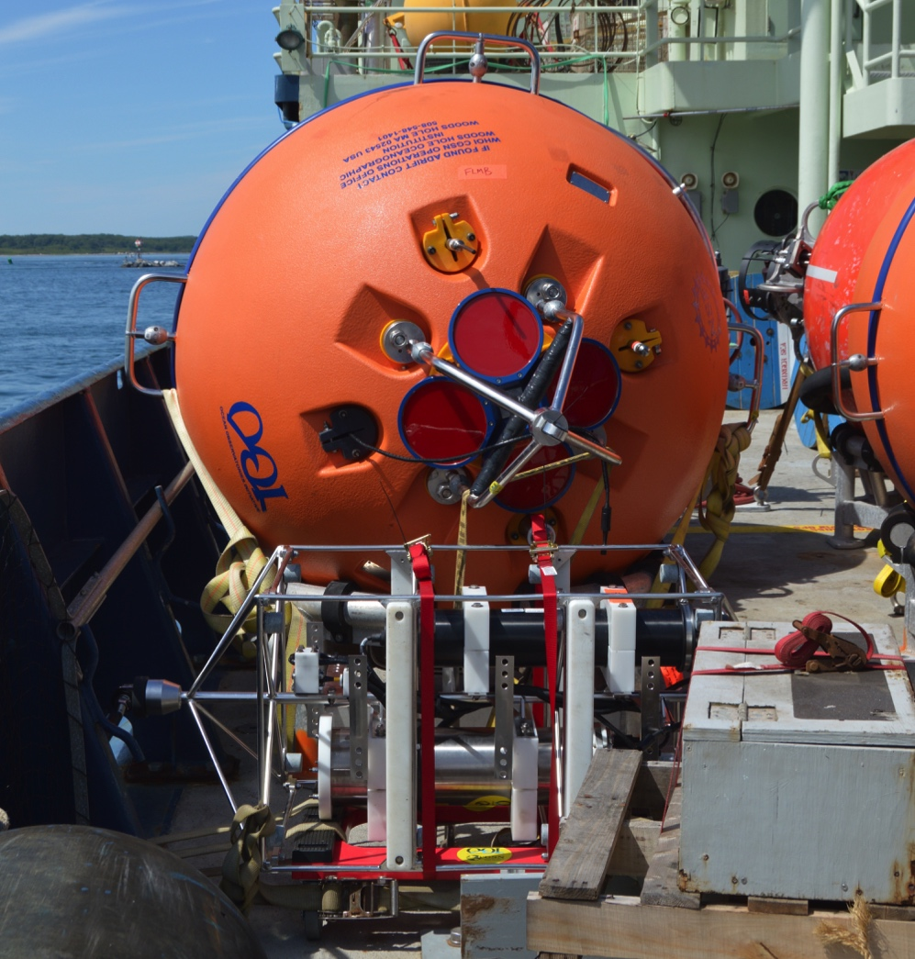
Global Moorings

Slide 8
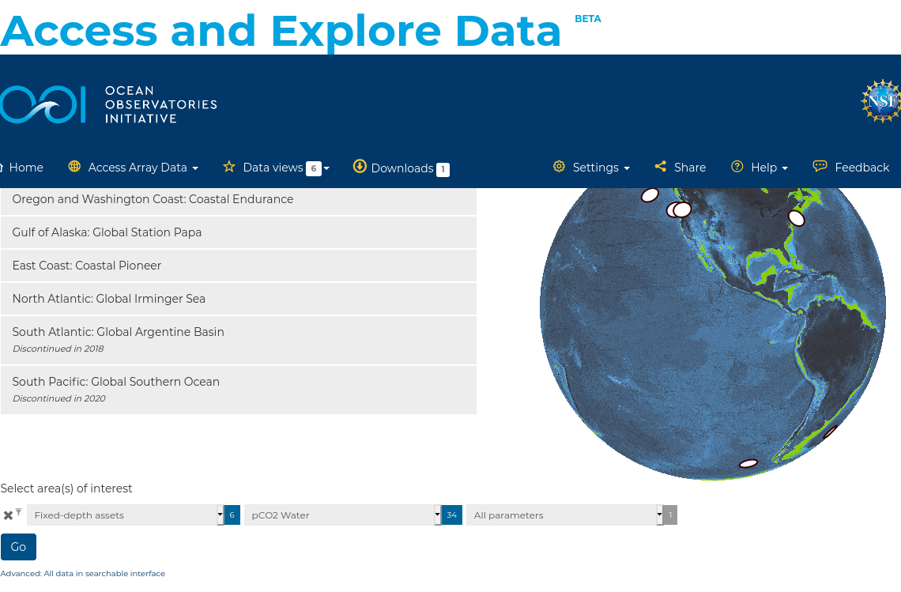
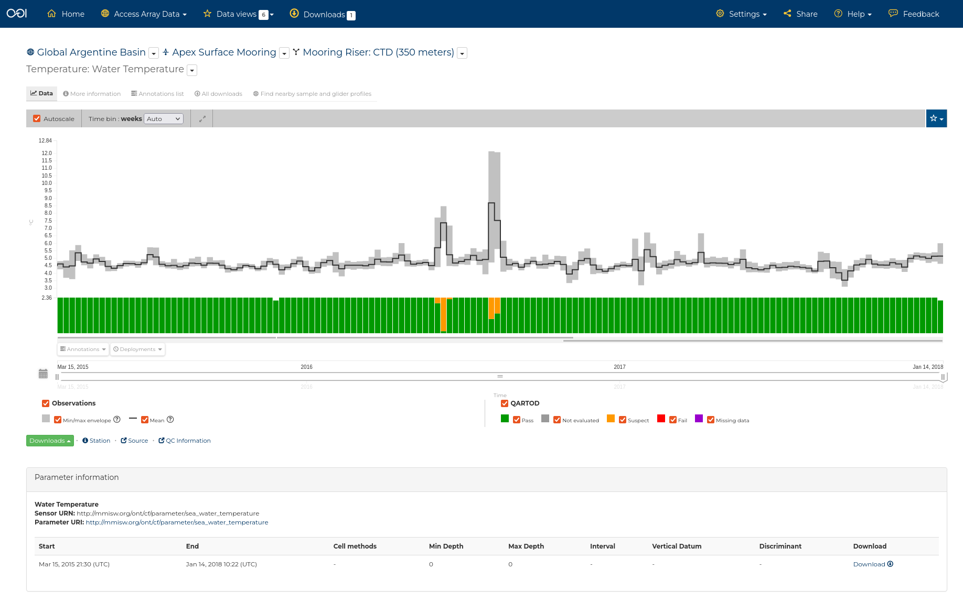
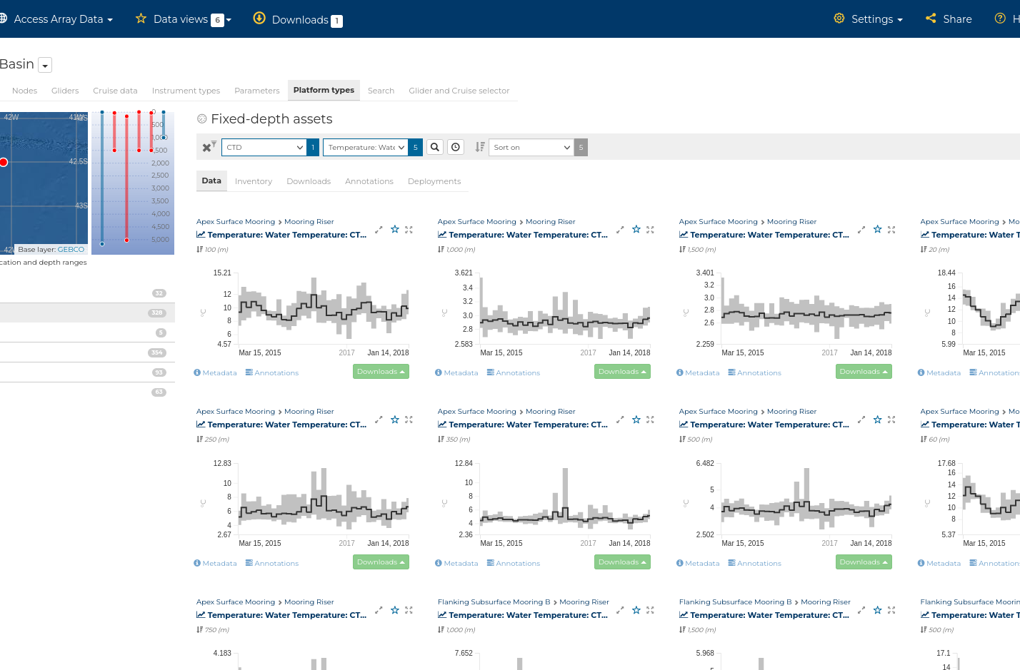
Data Source: Data Explorer
Direct data download via ERDDAP server:
https://erddap.dataexplorer.oceanobservatories.org/erddap

Slide 9
Methods
OOI Implementation of IOOS QC QARTOD library (github link)
Applied to data on a reference designator by reference designator basis
Gross Range
Define “bad” data based on calibration or mechanical properties of the sensor
Fit a mean to the available dataset
Calculate the standard deviation of the dataset
Define “suspect/interesting” data based on mean +/- 5-standard deviations
Climatology
Calculated using a 2-cycle harmonic fit to monthly-averaged data for the entire available timeseries:
Get all available data for a reference designator
Bin the data into year-month bins and take the average
Fit the average with a two-cycle harmonic to get monthly fit
Group the data by month and calculate monthly standard deviation
Calculate monthly ranges as monthly fit +/- two monthly standard deviations
“Suspect/interesting” data is data which falls outside of the monthly span - don’t define “bad” data
For profilers/vehicles - break down fits based on standard depth bins

Slide 10
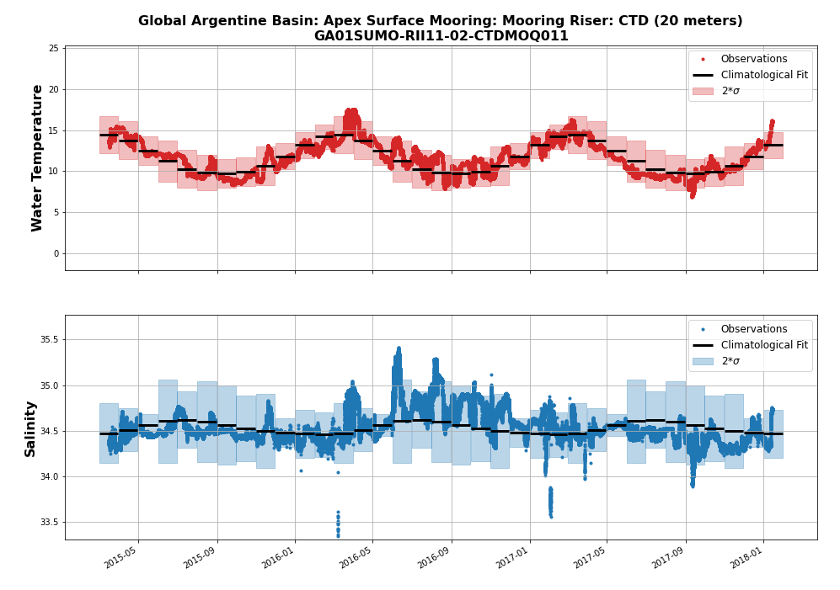
Methods: Climatology Example
Calculated using a 2-cycle harmonic fit to monthly-averaged data:
Get all available data for a reference designator
Bin the data into year-month bins and take the average
Fit the average with a two-cycle harmonic to get monthly fit
Group the data by month and calculate monthly standard deviation
Calculate monthly ranges as monthly fit +/- two monthly standard deviations
“Suspect” data is data which falls outside of the monthly span - don’t define “bad” data
The CTD seawater temperature (top) and practical salinity (bottom) fitted using the described climatology method to calculate the monthly-fit (black bars) and the monthly ranges (shaded areas).

Slide 11
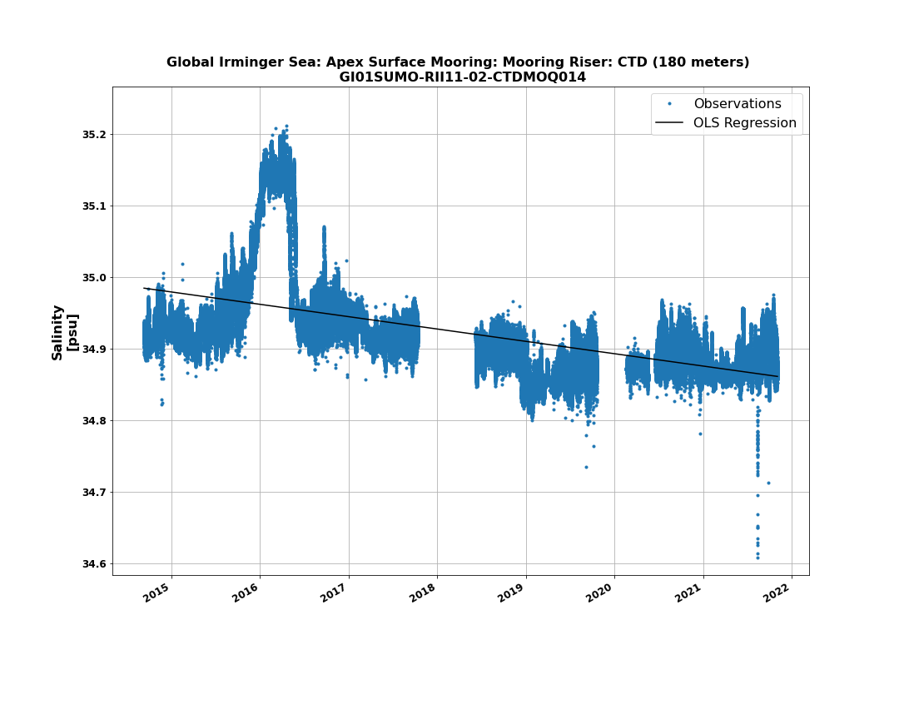
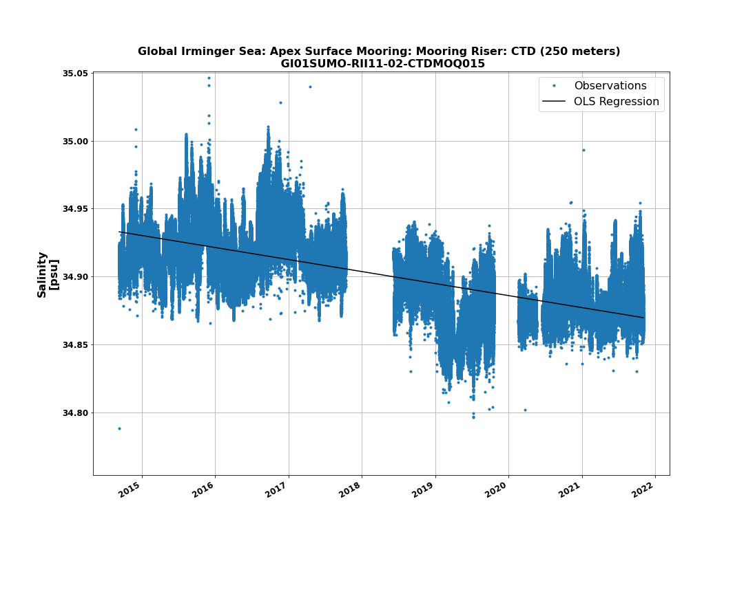
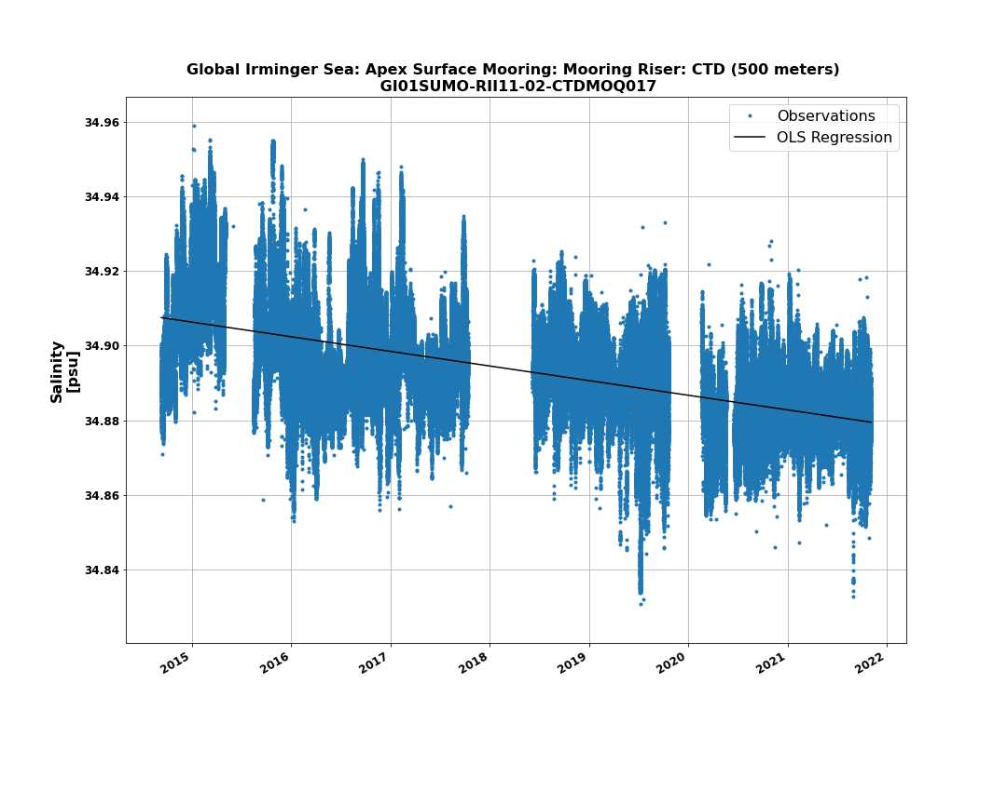
Irminger Array Freshening
The CTD practical salinity for the Global Irminger Surface Mooring CTD at 180 m with the long-term freshening trend shown with a solid black line.
The CTD practical salinity for the Global Irminger Surface Mooring CTD at 250 m with the long-term freshening trend shown with a solid black line.
The CTD practical salinity for the Global Irminger Surface Mooring CTD at 500 m with the long-term freshening trend shown with a solid black line.
Notes:
Can see the freshening throughout the water column

Slide 12
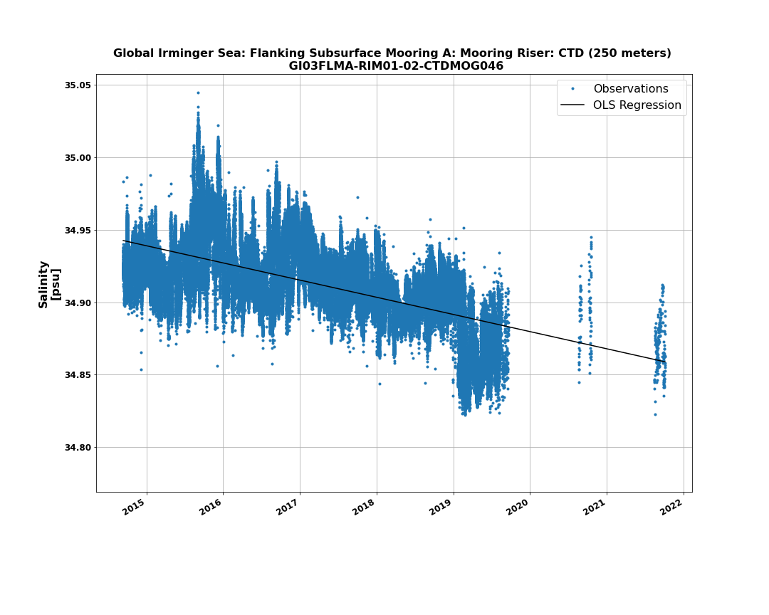
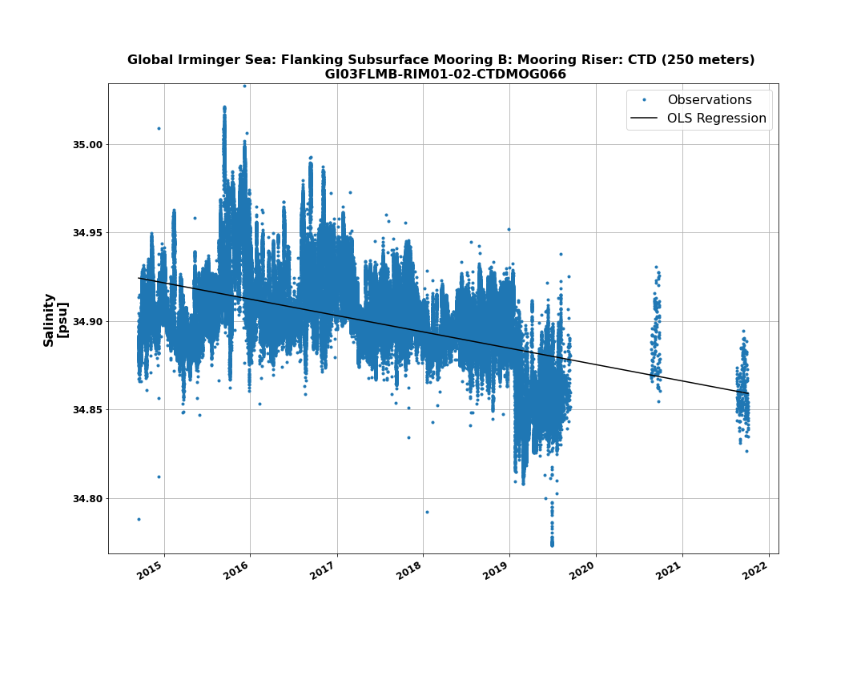
Irminger Array Freshening
The practical salinity from the Global Irminger Surface Mooring CTD located at 250 m depth.
The practical salinity from the Global Irminger Flanking Mooring A subsurface mooring CTD located at 250 m depth.
The practical salinity from the Global Irminger Flanking Mooring B subsurface mooring CTD located at 250 m depth.
Notes:
Can also see it across the array on both the surface mooring instruments as well as those on the fln

Slide 13
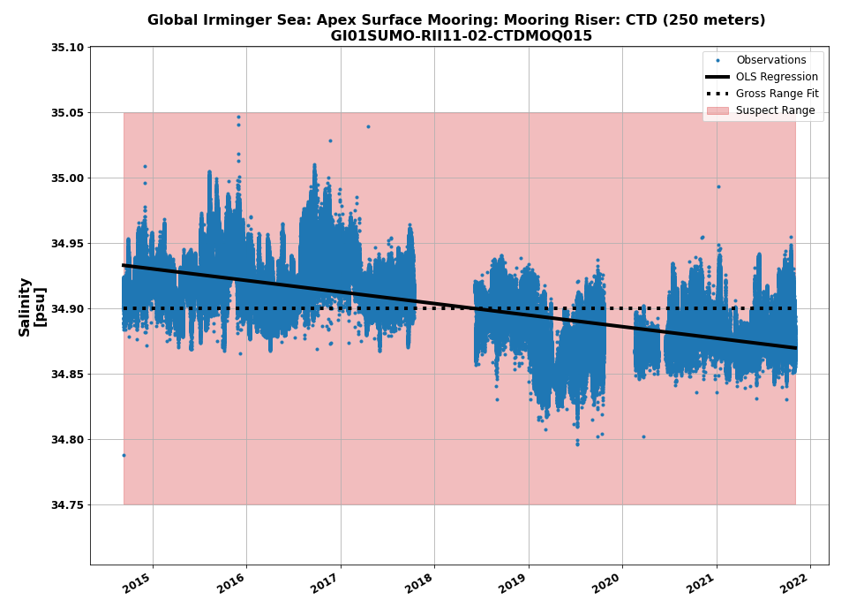
QARTOD Thresholds
Goal: (1) Identify obviously bad data and (2) flag data that are likely bad based on statistics while not flagging data that are from natural variability
Results:
Choice of 5-standard deviations is sufficiently relaxed to not flag natural time series variability
Fitting algorithm is simple to implement and replicate
If freshening continues, may start flagging data that are actually good
Periodic updates may be necessary
The CTD practical salinity for the Global Irminger Surface Mooring CTD at 250 m fitted using the described gross range method to calculate the time series average (black dashed line) and the suspect threshold (red range). The long-term freshening trend is shown with a solid black line.

Slide 14
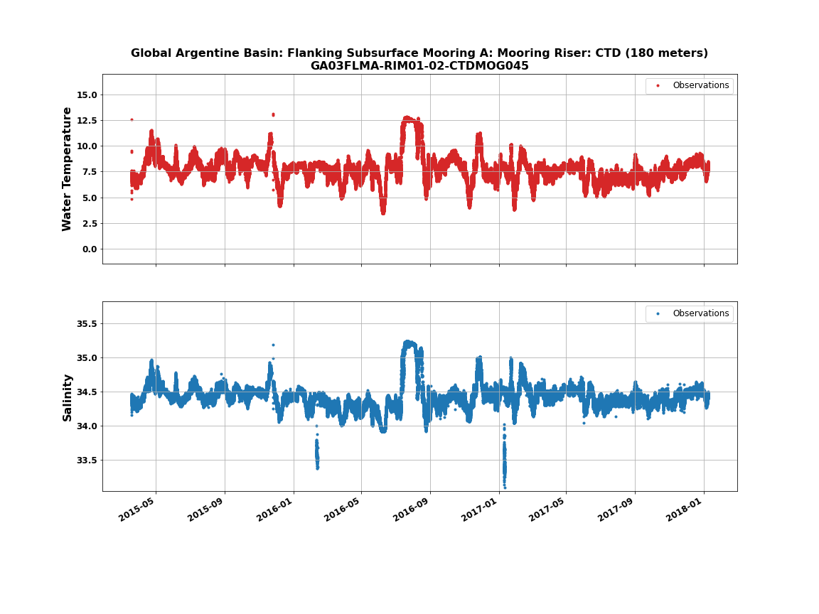
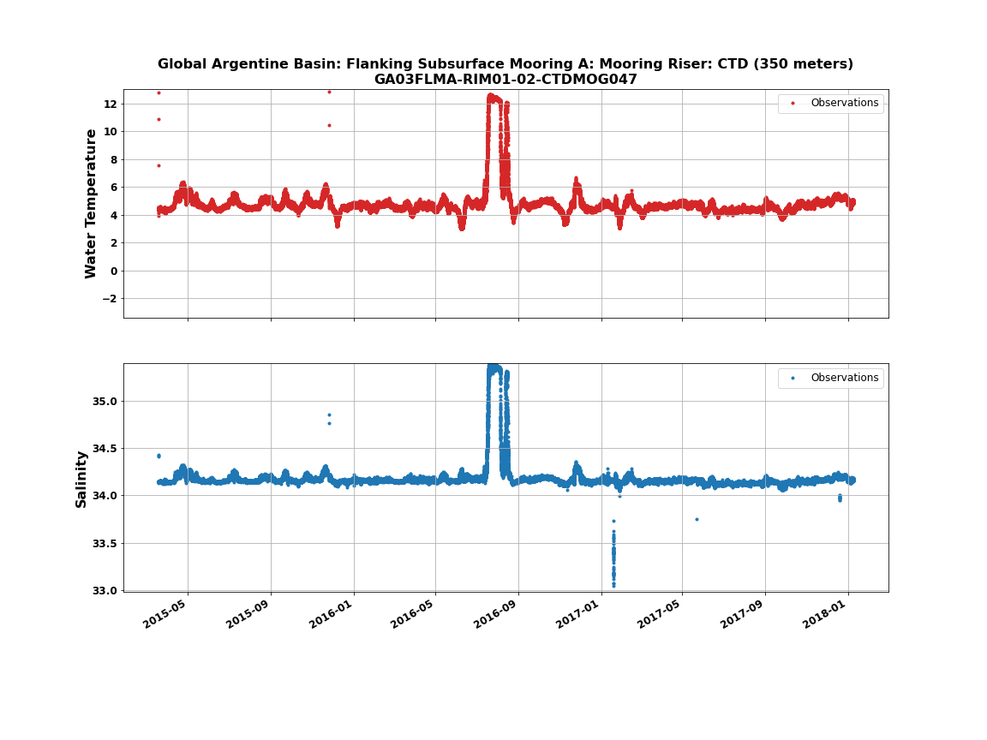
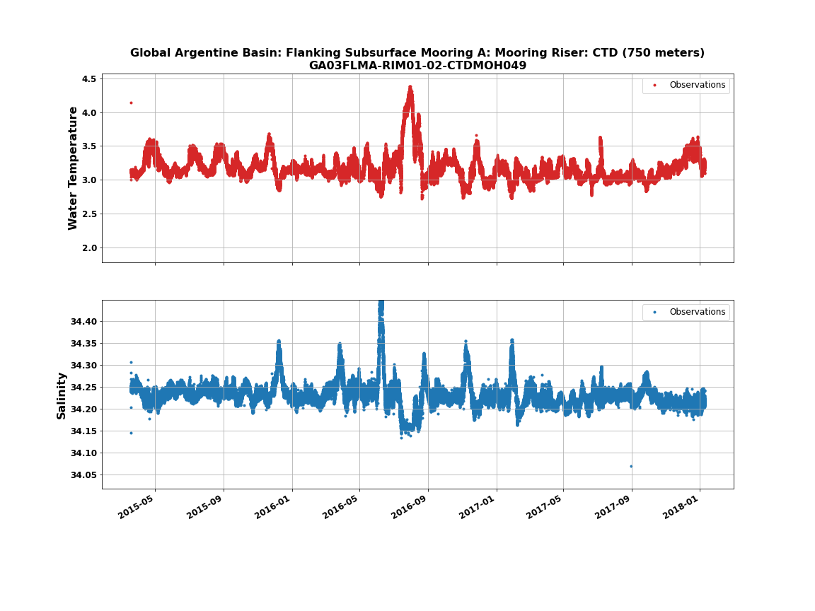
Argentine Basin Eddy
The seawater temperature and practical salinity from the Argentine Basin Flanking Mooring A CTD located at 180 m depth.
The seawater temperature and practical salinity from the Argentine Basin Flanking Mooring A CTD located at 350m depth.
The seawater temperature and practical salinity from the Argentine Basin Flanking Mooring A CTD located at 350m depth.
Notes:
The Flanking Mooring A has the largest signal at 350 m. Its huge - perfect candidate to see how

Slide 15
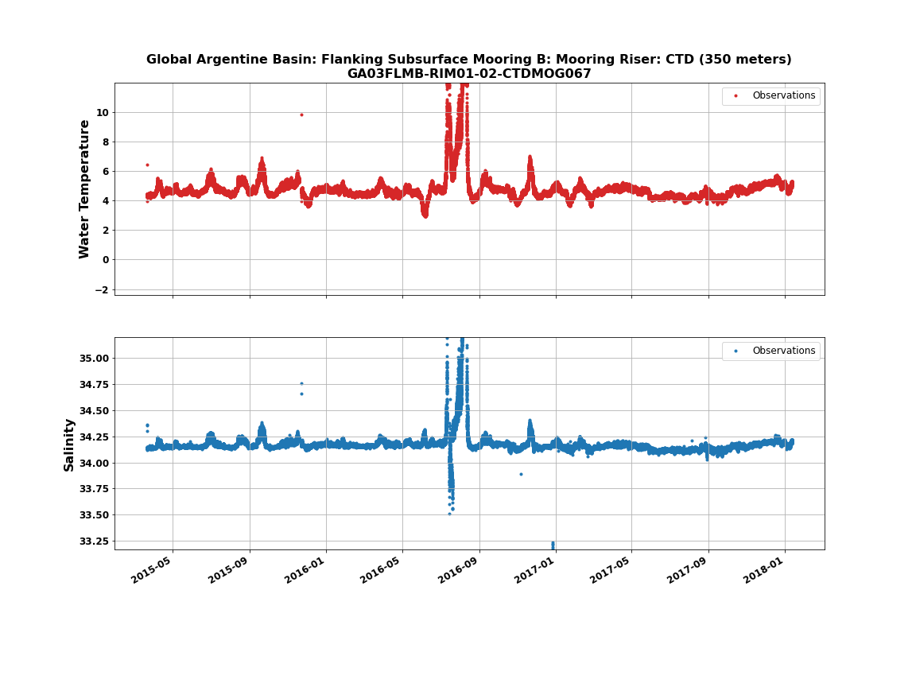
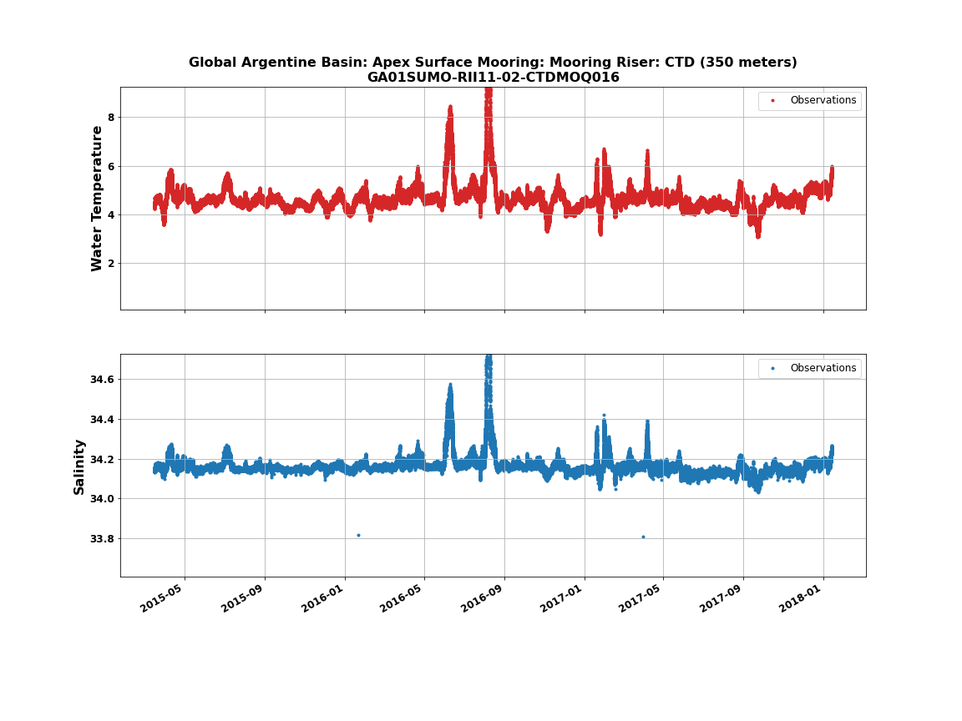
Argentine Basin Eddy
The seawater temperature and practical salinity from the Argentine Basin Flanking Mooring A CTD located at 350m depth.
The seawater temperature and practical salinity from the Argentine Basin Flanking Mooring B CTD located at 350m depth.
The seawater temperature and practical salinity from the Argentine Basin Apex Surface mooring CTD located at 350m depth.
Notes:
The Flanking Mooring A has the largest signal at 350 m. Its huge - perfect candidate to see how

Slide 16
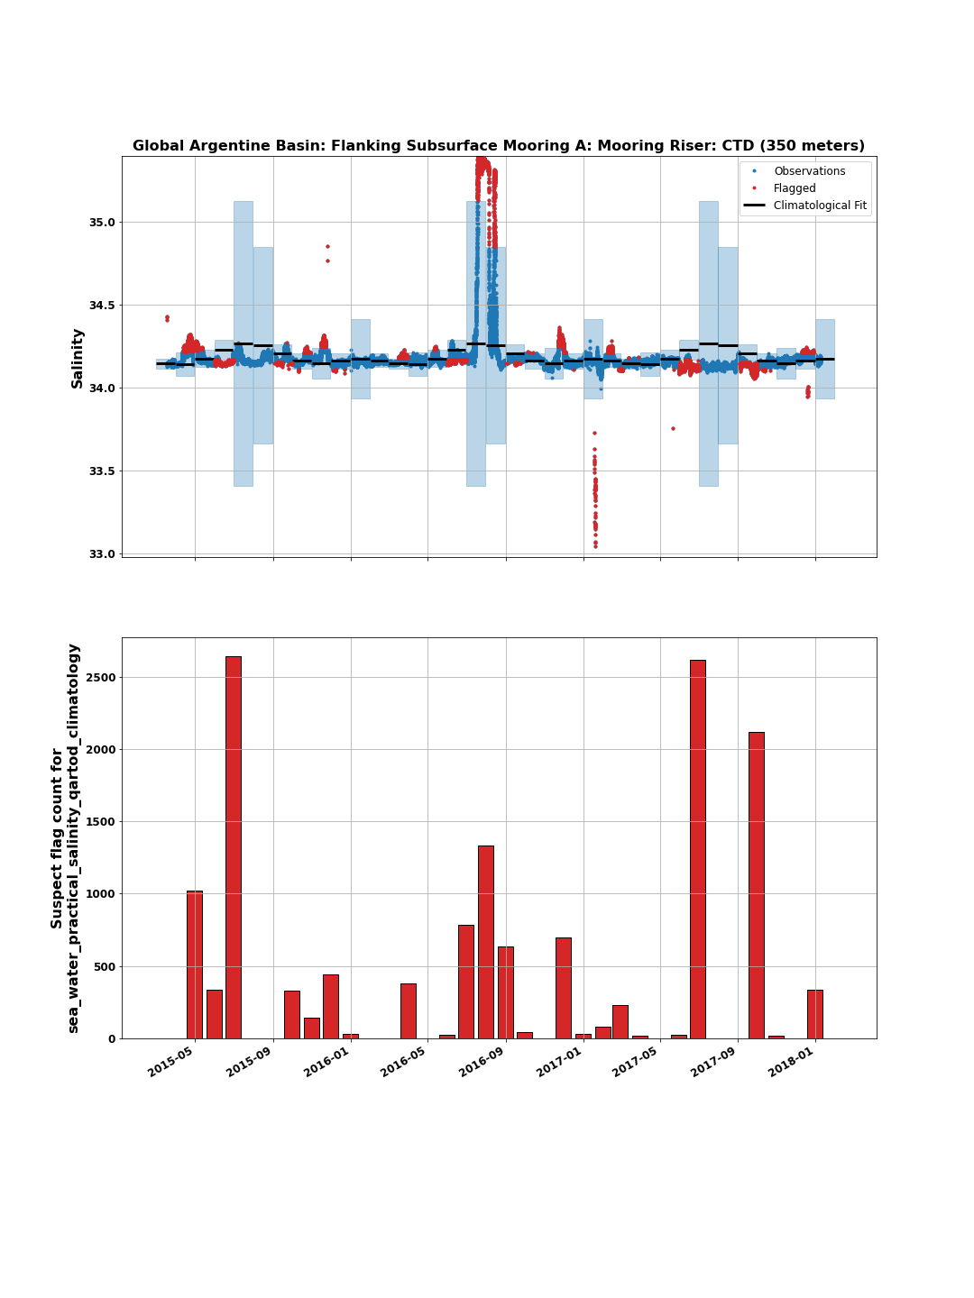
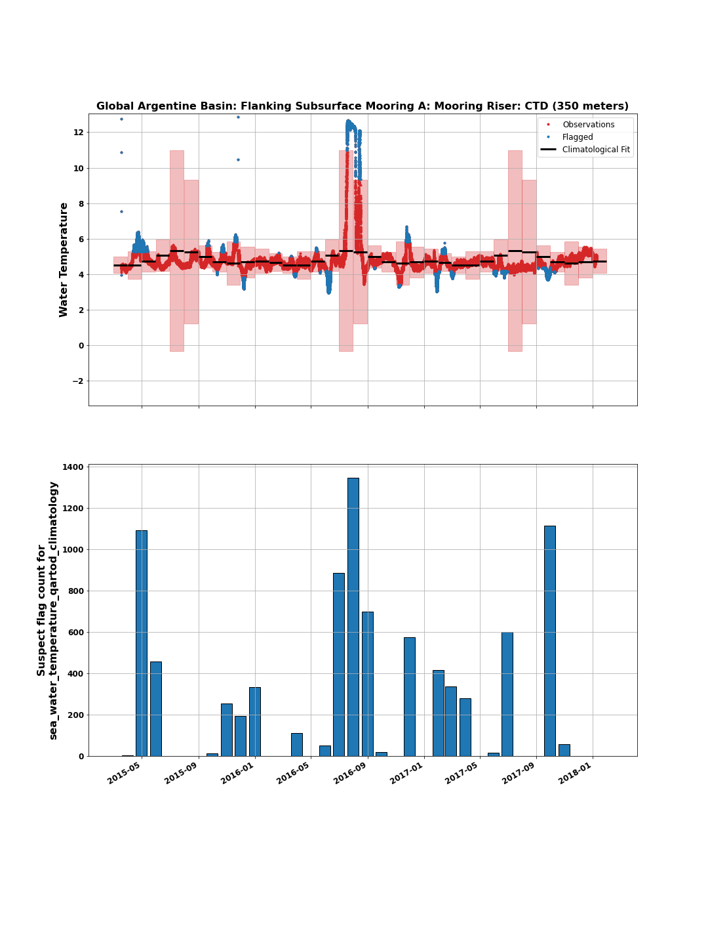
Climatology
(Top) The practical salinity from the Argentine Flanking Mooring A CTD at 350 m depth fitted using the described climatology method to calculate the monthly-fit (black bars) and the monthly ranges (shaded areas). Flagged data is in red. (Bottom) A histogram of the flagged data by month for the time-series.
(Top) The seawater temperature from the Argentine Basin Flanking Mooring A CTD at 350 m depth fitted using the described climatology method to calculate the monthly-fit (black bars) and the monthly ranges (shaded areas). Flagged data is in blue. (Bottom) A histogram of the flagged data by month for the time-series.
Notes:
The Flanking Mooring A has the largest signal at 350 m. Its huge - perfect candidate to see how

Slide 17
Climatology
Goal: Identify data which may be of interest, e.g. the passage of an eddy
Results:
Two-cycle harmonic fit to existing data captures seasonal variability
Shorter time-series can be biased by large deviations in the dataset
The eddy biases the monthly fit of July and August high
Choice of how to calculate the ranges has a significant impact on what data gets flagged
E.g. ranges for the months of July & August are significantly larger than any other month
Also, the monthly-binned standard deviation likely under-flags the eddy
(Top) The practical salinity from the Argentine Basin Flanking Mooring A CTD at 350 m depth fitted using the described climatology method to calculate the monthly-fit (black bars) and the monthly ranges (shaded areas). Flagged data is in red. (Bottom) A histogram of the flagged data by month for the time-series.
Notes:
The Flanking Mooring A has the largest signal at 350 m. Its huge - perfect candidate to see how

Slide 18
Conclusions
QARTOD tests are a valuable tool for implementing automated data quality control
QARTOD tests require choices for thresholds, input values, etc in order to flag data. This make them responsive to the methods of determining the input values.
Gross Range Test:
Choice of 5-standard deviations is sufficiently relaxed to not flag natural time series variability
Not currently impacted by freshening trend - but if trend continues will need to be updated.
Climatology Test:
Two-cycle harmonic captures seasonal variability well
Method of binning and calculating ranges will impact flag rates and if it flags natural phenomena
Short time-series are likely more sensitive to this as well
Notes:
The Flanking Mooring A has the largest signal at 350 m. Its huge - perfect candidate to see how

Slide 19
Resources
Explore OOI Data with our new Data Explorer: https://dataexplorer.oceanobservatories.org/
IOOS QARTOD Manuals: https://ioos.noaa.gov/project/qartod/
QARTOD code & documentation (maintained by IOOS & Axiom Data Science): https://github.com/ioos/ioos_qc
OOI Discourse for questions and discussion: https://discourse.oceanobservatories.org/
Notebooks used to prepare the data and figures in this presentation are available at https://github.com/reedan88/Ocean-Sciences-2022

Slide 20


Questions?

